Slide 1
Basic Actor Coding

Slide 2
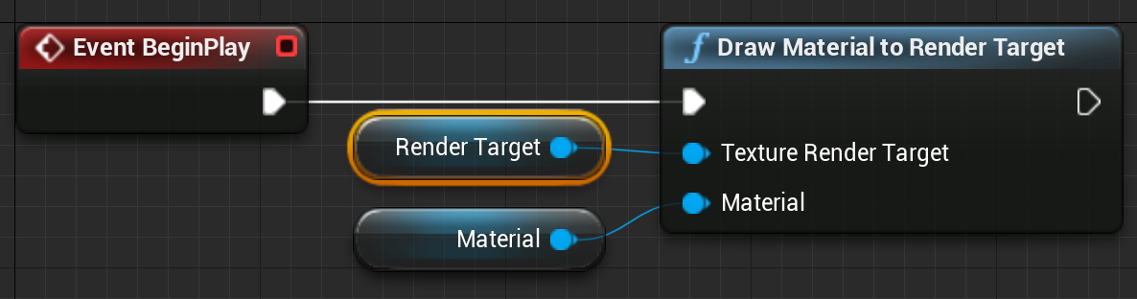
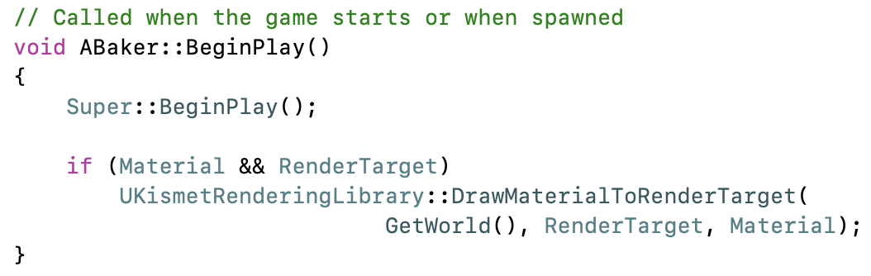
Actor Code
A UE4 Actor is any object in the Level. Actors are not used just for characters, but also for every visible scenic element, every light source, every invisible trigger region, and anything else that can have a position in the scene and possibly some attached behavior.
The best-documented way to add that behavior is with the Blueprint visual scripting system.
For more power and control, you can do the same thing in C++. C++ code has access to anything that can be done in Blueprint, plus internal functions and external libraries that are not Blueprint accessible.

Slide 3
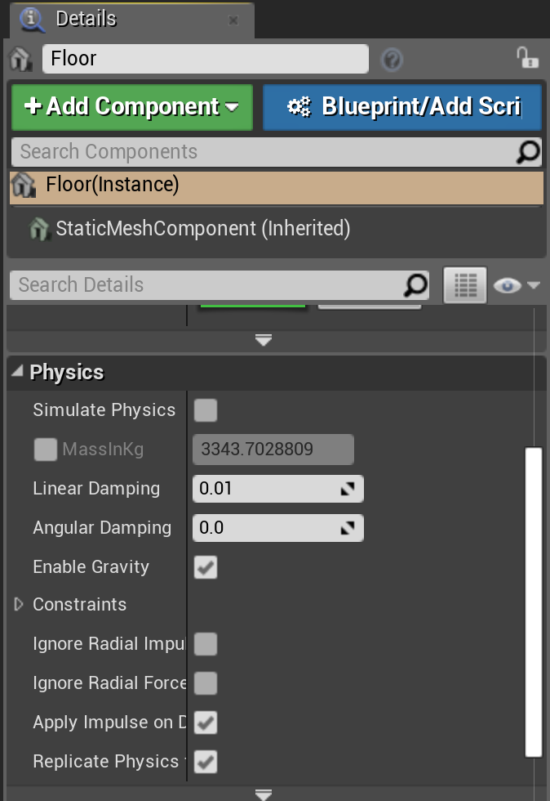
Actor Components
A component is a class that implements common behavior to be shared by many different types of Actors.
You can use components in both Blueprint and C++ Actors to add behavior, and can create new components to be used by both Blueprint and C++ Actors.
Common examples include Scene Components for Actor position, Mesh Components for rendering, physics and movement components for Actor motion, AI components for behavior, and networking components for communication.

Slide 4
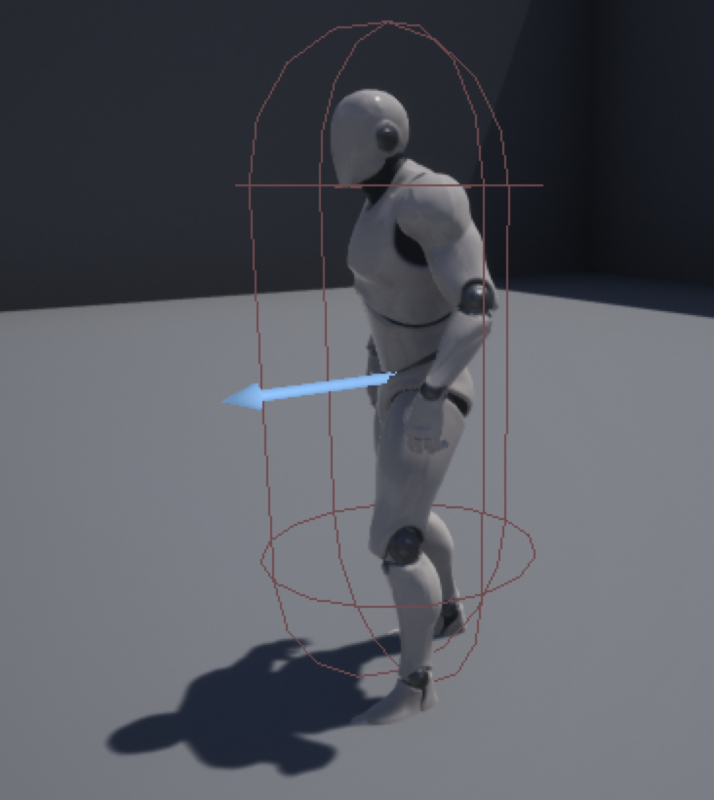
Pawns
A Pawn is an Actor that can be controlled by either the user or AI. The Pawn class is derived from the Actor class, so inherits all of the functionality of the base Actor class.

Slide 5
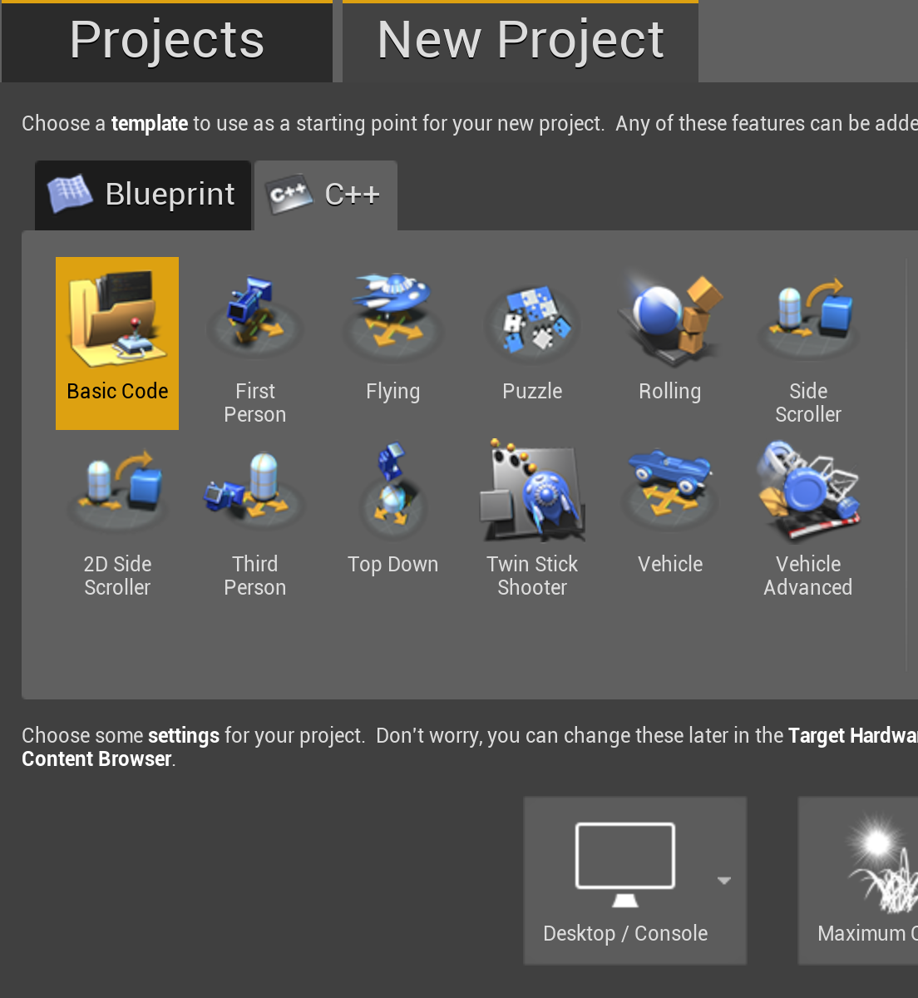
Creating a C++ Project
To do C++ Actor coding, you’ll need to create a C++ project rather than a Blueprint project.
You don’t need the engine source to do Actor and game C++ coding, but if you are going to be making any engine changes or extensions later, it’s best to put the project in the base directory of your engine repository (alongside the GenerateProjectFiles script).

Slide 6
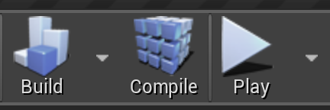
Recompiling Code
You can recompile Actor or component code when you make changes without having to exit the Editor. Just press the Compile button in the main toolbar.
The changed code will be recompiled and reloaded into your running Editor.
To manage the hot reload, UE4 saves the class data with the old class, then loads it with the new. If class data changes significantly, you may need to delete the Actor from the scene and read it, but most changes will just work.

Slide 7
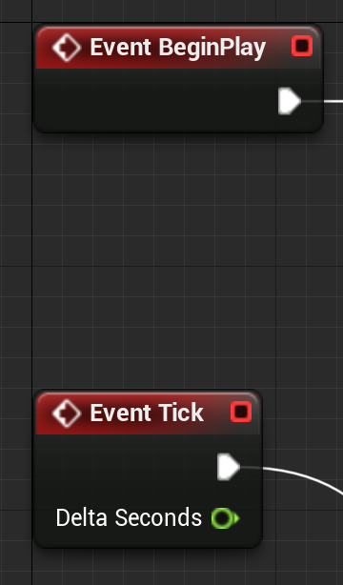
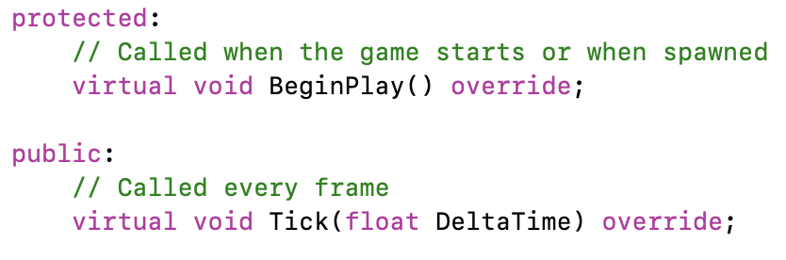
Core Blueprint Events ⇔ C++ Functions
The standard Blueprint Actor has event blocks so you can trigger something to happen on Actor Construction, Begin Play, or every game Tick.
The same options are available in C++ as virtual member functions OnConstruction, BeginPlay, and Tick.
When you create a new Actor class, it automatically creates templates for the BeginPlay and Tick functions, but you can add others. Look at the AActor base class and its parents to see what is available.
Overriding these virtual functions adds behavior for that Actor event.

Slide 8
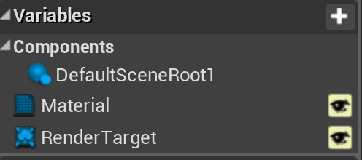
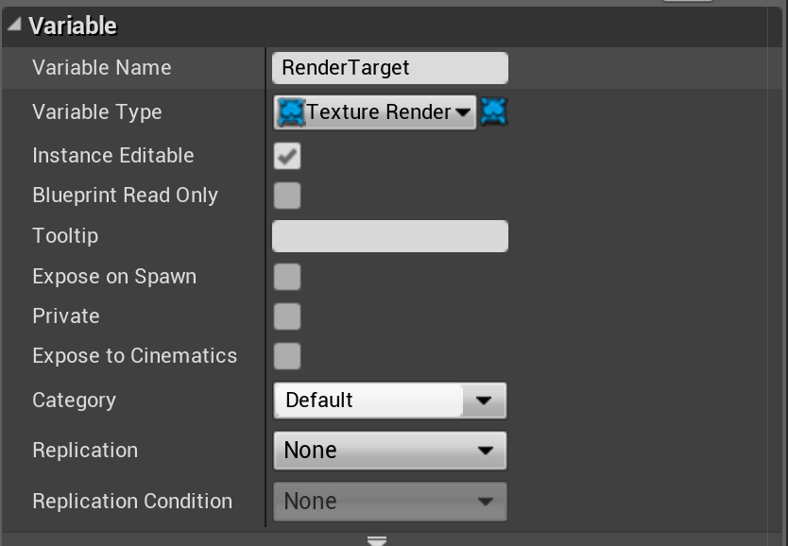
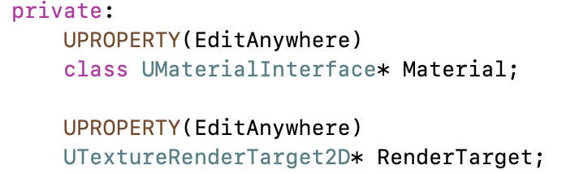
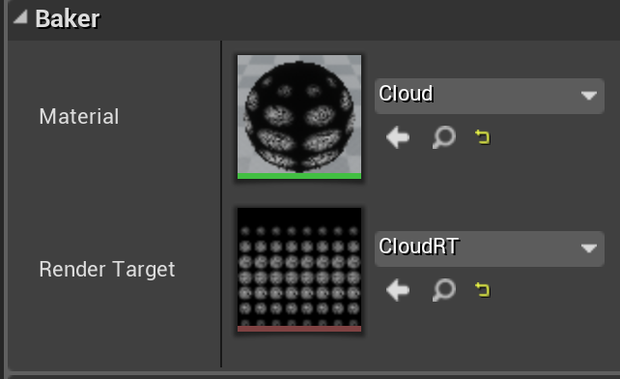
Blueprint Variables ⇔ C++ Member Data
In Blueprint, you can create variables associated with your Actor. Values for these are saved with the Actor. These can be set to be either visible in the Actor’s Details window, or internal and hidden.
In C++, any member variable preceded by the UPROPERTY() macro will be saved with the Actor, but hidden. Variables without UPROPERTY() can hold temporary data, but will not be saved.
A member variable preceded by “UPROPERTY(EditAnywhere)” will be visible and changeable in the Editor Details window.
Default values for variables are set in the class constructor, though be aware that the constructor is not run when restoring from a save.

Slide 9
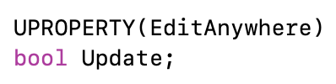
UPROPERTY Magic
The UPROPERTY macros are parsed by the Unreal build process to generate user interface and serialization (saving and loading) code.
Comments before the UPROPERTY will show up as a pop-up tooltip.
Arguments to UPROPERTY can control many aspects of how it will appear, including changing the displayed name, setting min and max slider bounds, or setting a hard min and max value for the UI (code can still create out-of-range values).
See online documentation for all of the options.

Slide 10
Converting a Blueprint Project to C++
If you start a project using Blueprint and decide later to do some C++, it is possible to switch it over.
In the Content Browser, create a new C++ class (e.g., a new C++ Actor class for Actor behavior).
After UE4 is done generating the files, quit the engine and then run the GenerateProjectFiles script.
When you relaunch the project, it’ll be a full-fledged C++ project.
You can identify code projects because they will have a Compile button in the toolbar.

Slide 11
Function Discovery

Slide 12
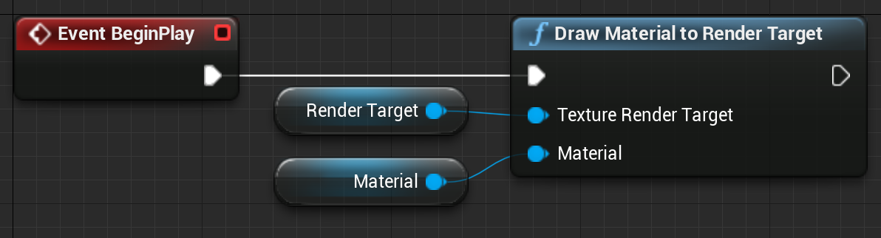
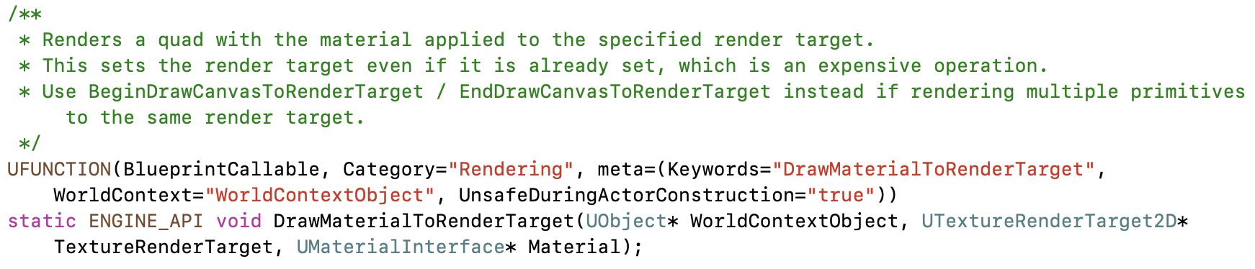
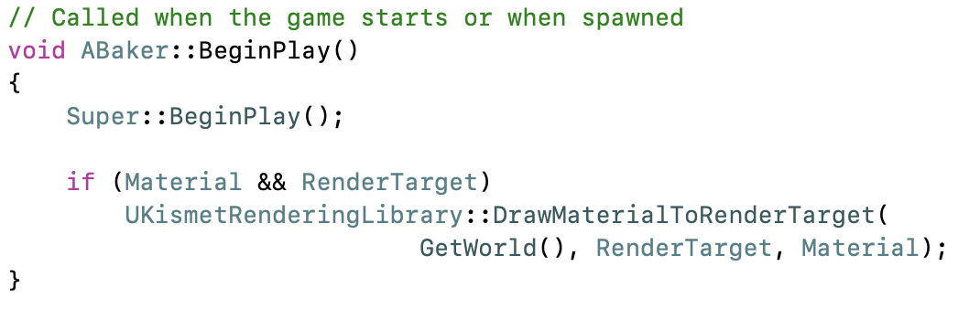
Blueprint Blocks ⇔ C++ Functions
One of the hardest things when getting started programming in an engine like UE4 is knowing what functions already exist and are available for you to use.
Fortunately, every core block in Blueprint is backed by a C++ function. Unless it was specified with a different display name, the function will have the same name as the Blueprint block, with spaces removed.
Search the code .h files for a matching function name. Include that .h at the top of your C++ file for access to the function.

Slide 13
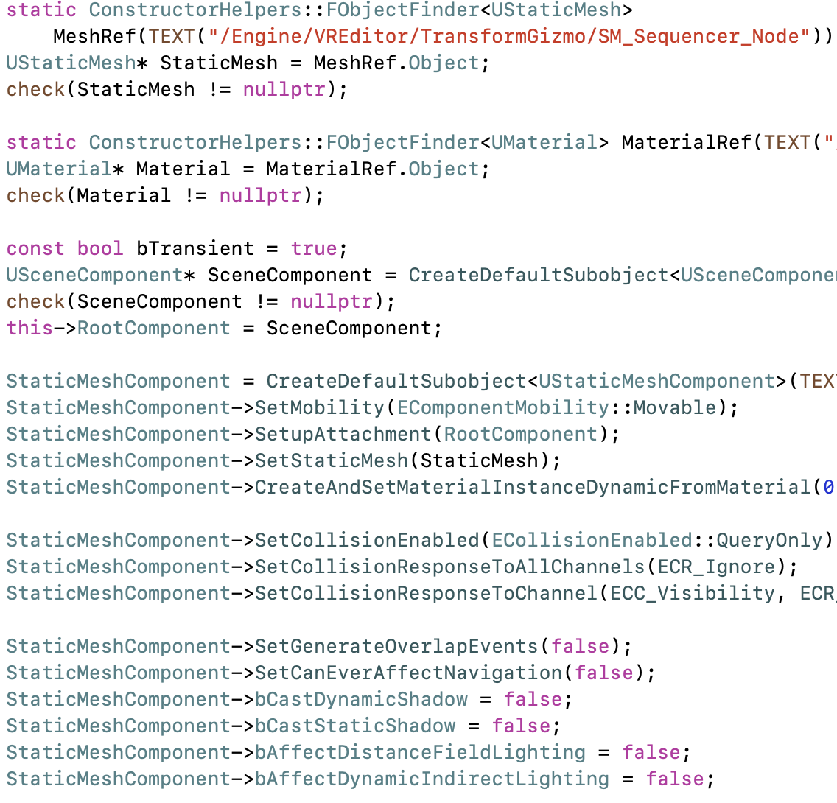
Engine Examples
Many of the things you want to do in Actor code are already done someplace in the engine. If you want to know how to use a particular component, search the engine .cpp files for someplace else where it is used.
If you don’t find an example of the particular component class, examples using its base class or a class derived from it can also prove useful.

Slide 14
Class Hierarchy
APawn
UObject
UObjectBaseUtility
AActor
UObjectBase
Character Actor
All Actors in scene
Any Object with serialization and garbage collection
Utility functions for all Objects (and Actors)
Where the garbage collection and serialization are actually implemented
While Blueprint or code examples are a great way to discover functions and classes that are available to Actor code, it is also helpful to browse the class definitions for data you can access, functions you can call, and virtual functions you can override.

Slide 15
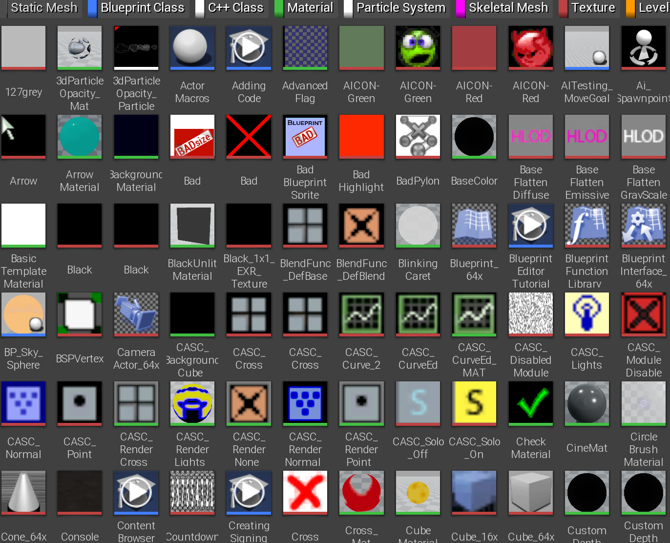
UObject
The base class for all Actors, Components, and Pawns is UObject. Most things derived from UObject have a name starting with “U” to make them easier to identify.
UObjects and classes derived from them support garbage collection and serialization (saving and loading) of all class states. All UObjects have a name, and can be looked up by name.
There are many virtual functions in the UObject base class: to run before or after a save or load, to change serialization from the default (especially for backward compatibility), and many more.
UObject also includes a GetWorld() function, which is handy for the many other functions that take the World as a parameter.

Slide 16
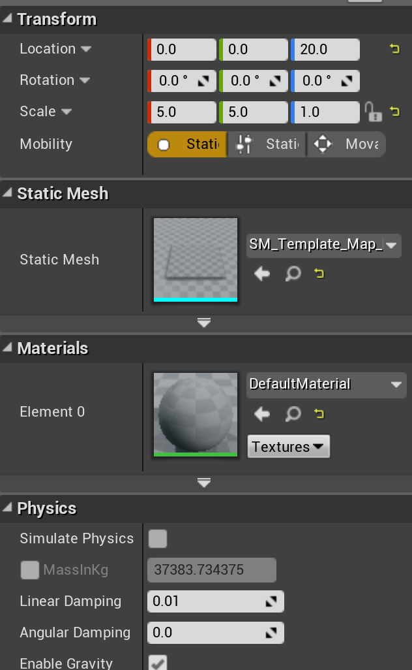
UActor Component
The base class for all components is derived from UObject, so inherits all its functions and data.
It adds the ability to activate and deactivate the component, and BeginPlay, EndPlay, and TickComponent virtual functions for overriding behavior.
Two key subclasses of UActorComponent are USceneComponent and UPrimitiveComponent.
A Scene Component is used for anything with a position in the scene. Actors often have one Scene Component set as their Root Component to provide the Actor’s position.
A Primitive Component is the base for components that can be drawn or provide a visual representation for an Actor.

Slide 17
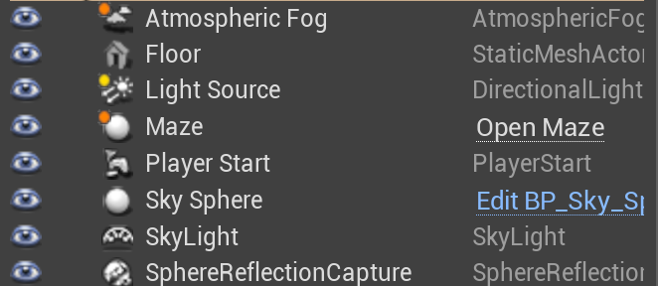
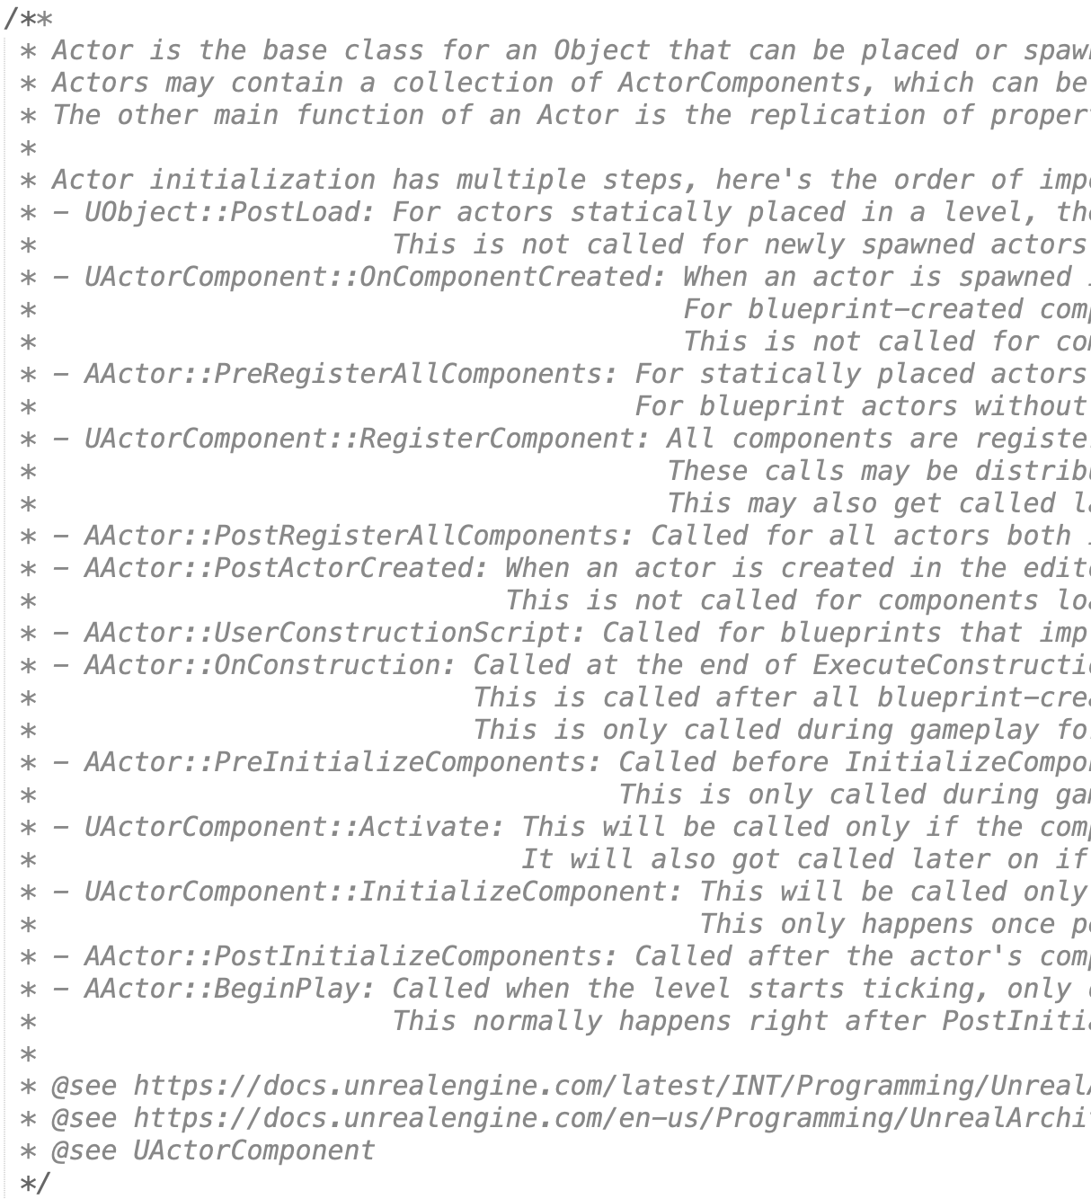
AActor
The AActor class is derived from UObject, but the leading character for the AActor class and any derived from it is switched to “A”.
It’s worth browsing through the (3,000-line!) declaration for the AActor class to see what it provides. These include the following:
Virtual functions you can override with new behavior like BeginPlay, Tick, etc.
Network replication functions and data
Child Actors, Child components
Functions and data for handling position, collisions, damage
Don’t forget to set one Scene Component as the Root Component of the Actor to be able to position it.

Slide 18
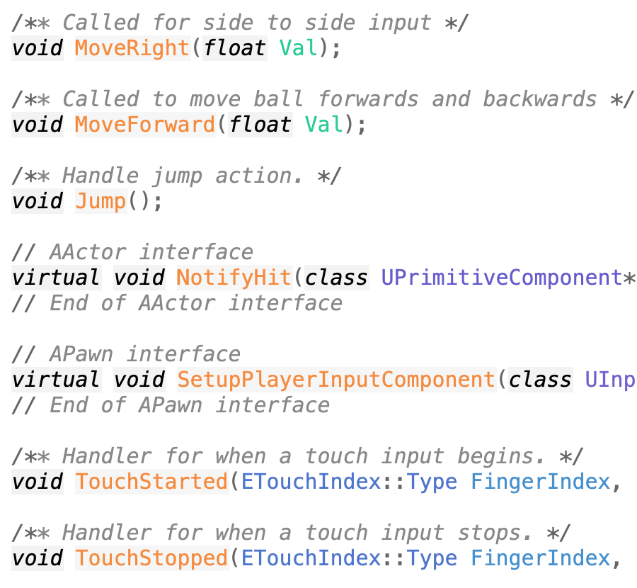
APawn
The APawn class is derived from AActor and adds virtual functions for controller and AI input.

Slide 19
Actor Debugging

Slide 20
Running in an IDE
If you are running your UE4 from a source build and place the project into the UE4 directory, it’ll be added to the UE4.sln (or UE4.xcworkspace on Mac).
Open this file in your IDE, and set your game project as the startup file.
Now you can run and debug your game project within the IDE. This includes C++ Actor code, plugins, or other code.

Slide 21
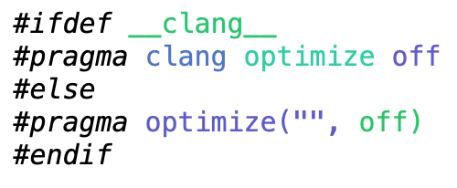
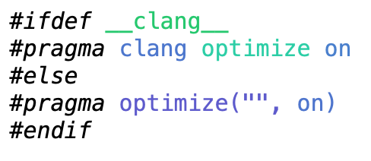
Turning Off Optimization
Compiler optimization can remove variables, rearrange code, and otherwise make debugging difficult. You can turn off optimization in a single .cpp file or around a single function using a pragma.
UE4 combines files together when building for efficiency, so be sure to turn the optimization back on after the code you are debugging.
And don’t forget to remove the pragma blocks when you are done debugging the file!

Slide 22
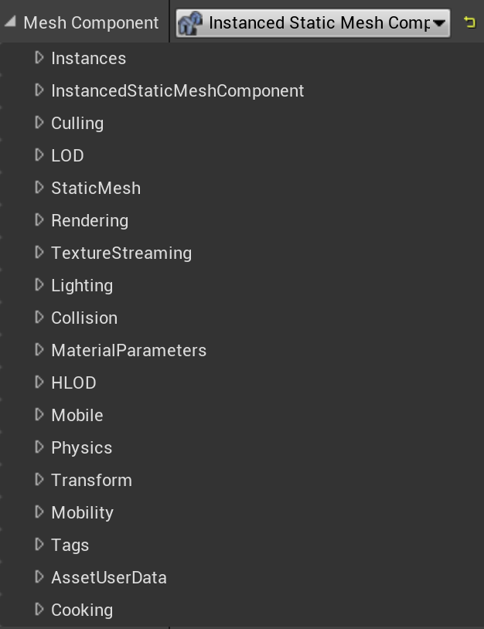
Exposing as a UPROPERTY
Even for data you don’t ultimately want to have in the editor interface for your class, it can be useful to be able to see its values while debugging. Tag the data with “UPROPERTY(EditAnywhere)” or “UPROPERTY(VisibleAnywhere)” to be able to see it in the Details window.
Don’t forget to switch back to “UPROPERTY()” when you’re done!

Slide 23
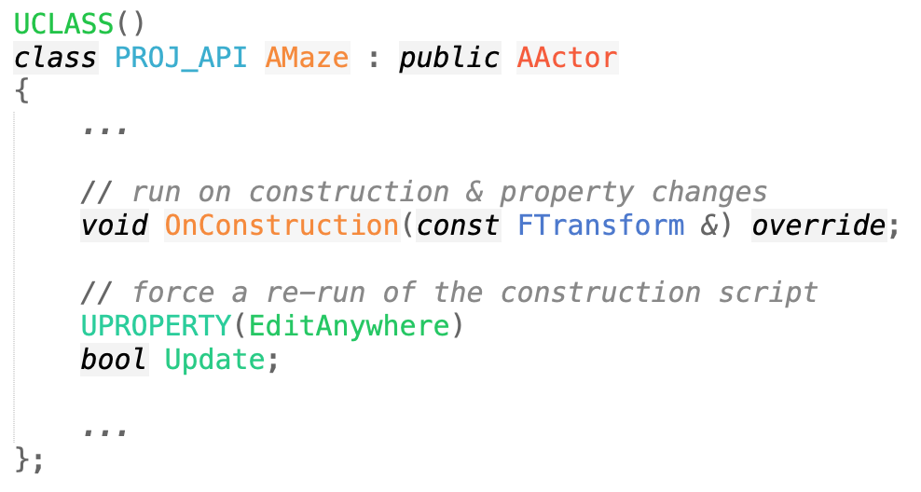
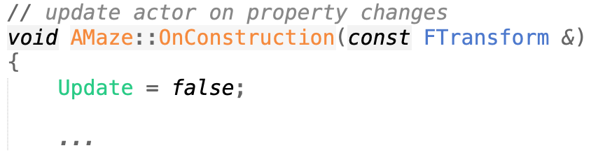
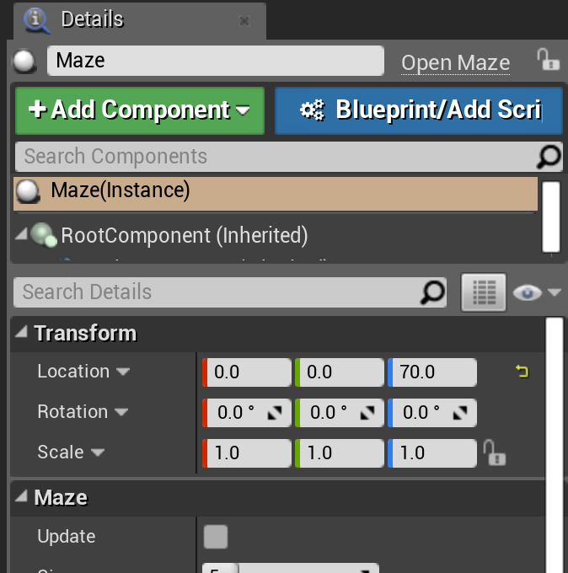
Update Button
Especially when testing an OnConstruction script, it can be handy to have a way to force it to rerun. Since it runs on any change, create a dummy Boolean data member. That will display as a check box, and your OnConstruction function will execute if it changes.
Set it back to false in the OnConstruction function to uncheck it again, ready for the next update.

Slide 24
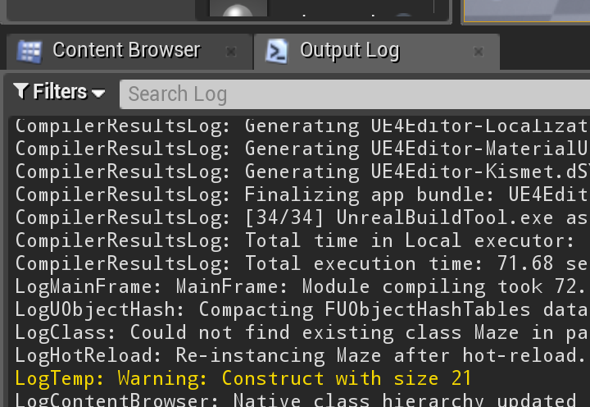
Messages
You can print log messages with UE4_LOG().These messages will appear in the Output Log window and in the console output.
For more, see the Unreal Engine wiki.

Slide 25
Inheritance

Slide 26
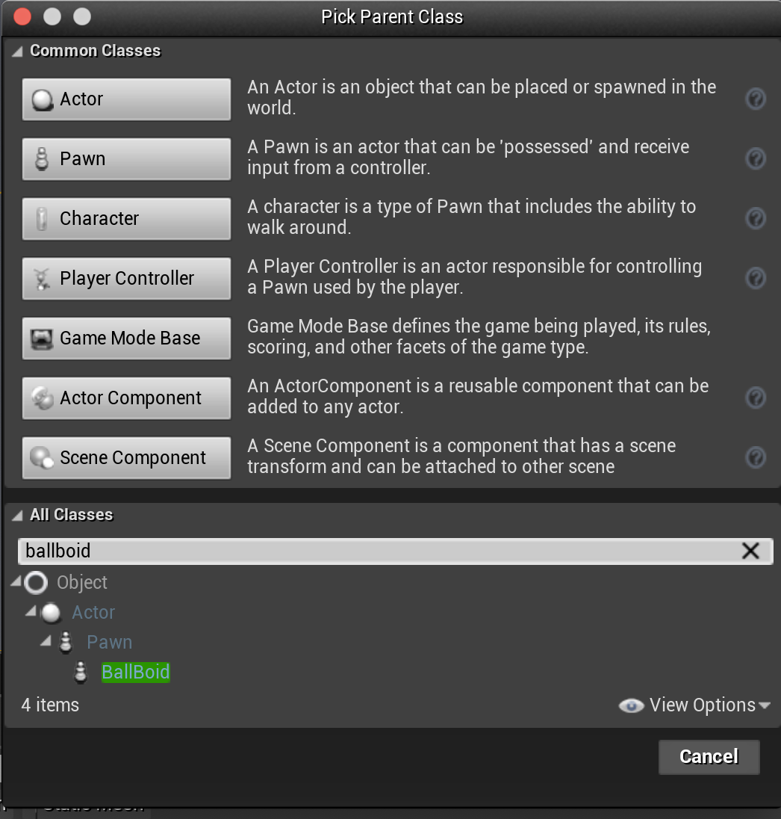
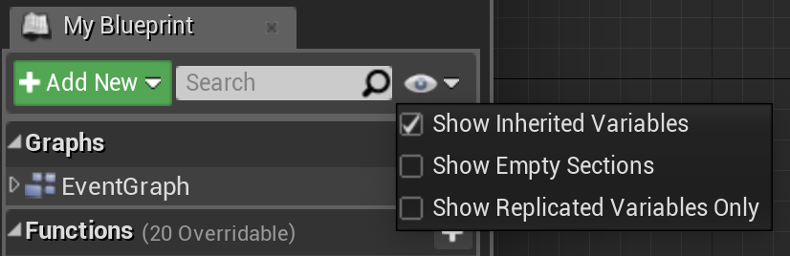
Extending a C++ Class in Blueprint
You can extend any C++ Actor by creating a Blueprint that is derived from it. The new Blueprint object inherits all of the code, variables, and behavior of the original, but can add additional functionality by overriding BeginPlay, Tick, OnConstruction, etc.
Choose “Add New > Blueprint Class”, but rather than choosing one of the standard classes at the top, search for your C++ class in the All Classes list on the bottom.
Any property you want to be accessible in the Blueprint extension should have the BlueprintReadWrite property. In addition, to see the inherited variables, be sure to make them visible in the Blueprint Editor.

Slide 27
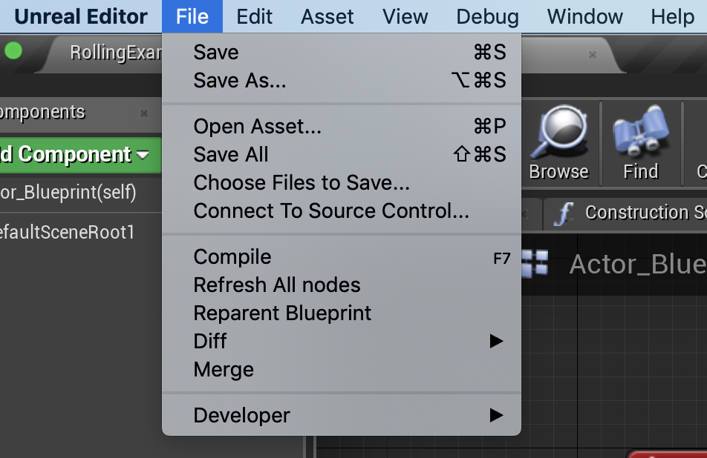
Extending a Blueprint Class in C++
While a Blueprint class can be derived from a C++ class, a C++ class cannot be derived from a Blueprint one.
Instead, create a new C++ class, then reparent the Blueprint class to it (File > Reparent Blueprint). Once you have reparented, you can move logic from the Blueprint class into the C++ parent class.
You can also create new C++ ActorComponents to add to an existing Blueprint class.

Slide 28
Calling Between Blueprint and C++

Slide 29
Mix C++ and Blueprint: Scripting
Why do many projects end up with a mix of C++ and Blueprint?
One of the main reasons Blueprint exists in the first place is to allow nonprogrammers or designers with limited programming experience a way to directly make gameplay changes.
C++ code that is callable from Blueprint can expose functionality to Blueprint that is either not available in the standard Blueprint nodes or is cumbersome to implement there.
Blueprint code that is callable from C++ can allow nonprogrammers on your team to tweak behavior by constructing small Blueprint functions rather than having to build out a full Actor or Component.

Slide 30
Mix C++ and Blueprint: Conversion
Many projects that start out as Blueprint may want to port some of that code to C++ for performance or programmability.
One approach is to replace small sections of Blueprint with local Blueprint nodes that do equivalent work in C++.
Another approach is to convert overall structure first, in which case you may need to call Blueprint parts that have not yet been converted from the C++ code.

Slide 31
Preparation
No matter what the reason, the first step to a mixed implementation is to have a Blueprint class derived from an underlying C++ class.
Reparent if the Blueprint is already created.
If not, create the C++, then make a Blueprint-derived class from it.

Slide 32
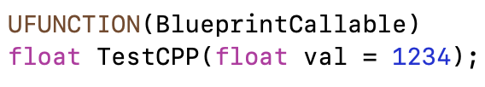
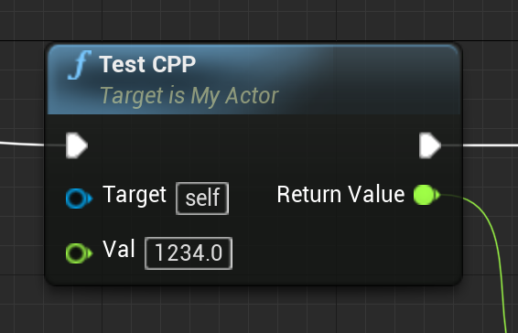
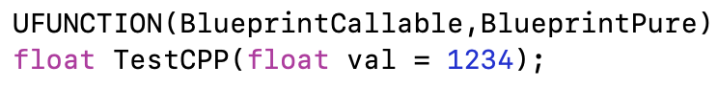
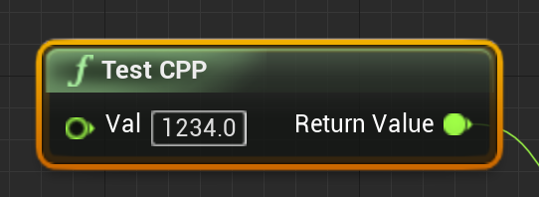
Exposing C++ Functions to Blueprint
To make a new Blueprint node, mark a function in your C++ class as UFUNCTION(BlueprintCallable).
The name will match the function name unless you add meta=(DisplayName=“name”).
The function parameters will appear as input pins. Any with default values in the C++ declaration will have those defaults in Blueprint.
The function output will appear as an output pin.
Add BlueprintPure to the UFUNCTION for pure functions that do not change their Actor state, where the execution order does not matter.

Slide 33
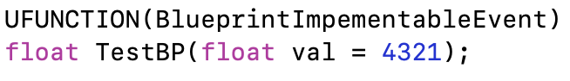
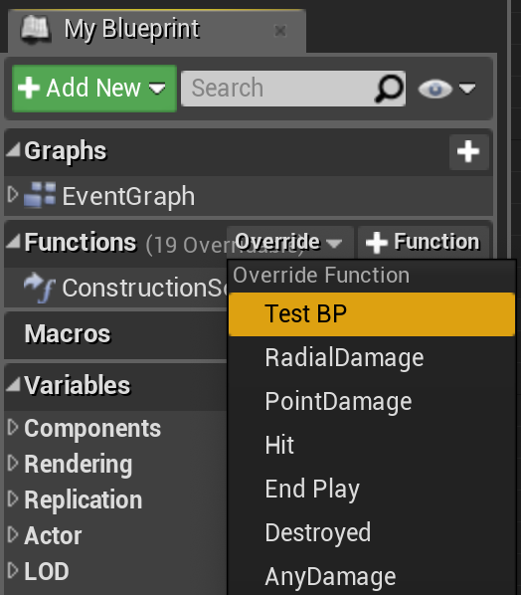
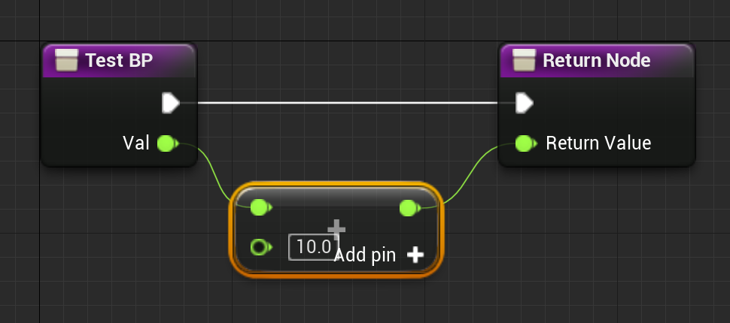
Blueprint Implementable Functions
To call a Blueprint function from C++, create a C++ function that will be overridden in the derived Blueprint.
Create a function in your C++, tagged with “UFUNCTION(BlueprintImplementableEvent)”.
In the Functions section of the Blueprint Editor, choose “Override”.
Create a Blueprint implementation.
Call in your C++ code.
A function can be both BlueprintImplementable and BlueprintCallable if you need to be able to call it from both.
It can also be BlueprintPure if it is a pure function without order-dependent side-effects.

Slide 34
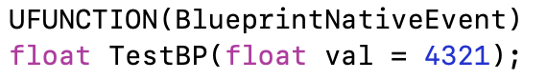
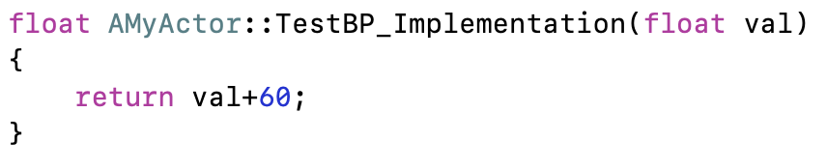
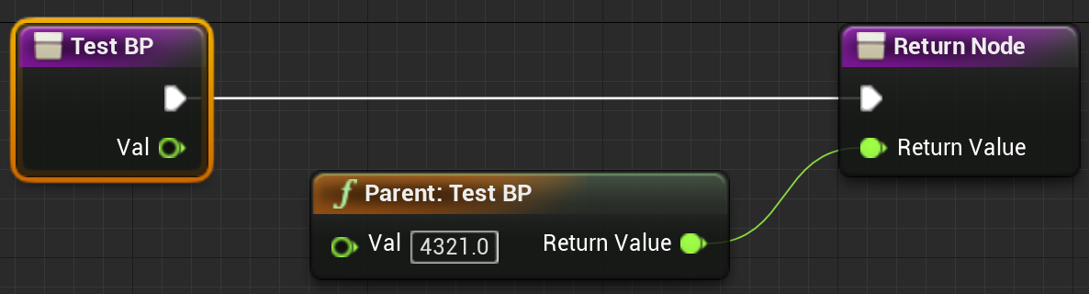
Blueprint Functions with C++ Default
To use a default C++ implementation when the Blueprint one does not exist, use UFUNCTION(BlueprintNativeEvent) instead of BlueprintImplementableEvent.
Create a C++ implementation function with “_Implementation” on the end of the function name. It will use this if a Blueprint version is not provided.

Slide 35
LABWORK

Slide 36
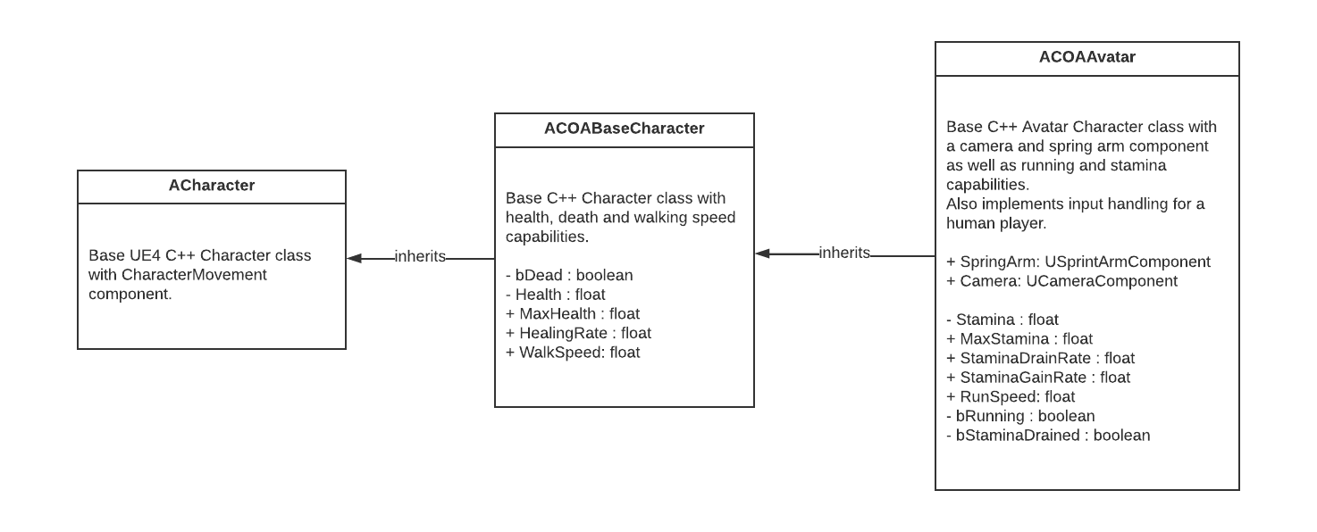
PROJECT: CLASH OF AVATARS (COA)
C++ CLASSES

Slide 37
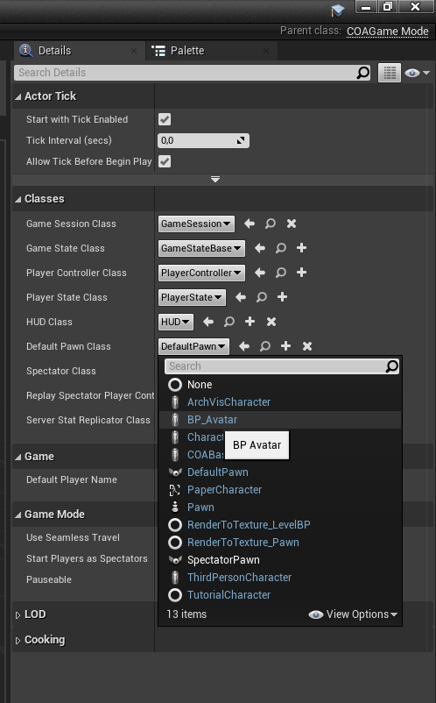

PROJECT: CLASH OF AVATARS (COA)
Implementation Steps #1 (COMPLETE!)
Our project’s short code prefix is COA.
Add «Public» COABaseCharacter class drived from Character.
Add «Public» COAGameMode class drived from GameModeBase.
Create Blueprints folder under Content root.
Add BP_Avatar blueprint derived from COABaseCharacter at Blueprints Folder.
Add BP_COAGameMode blueprint derived from COABaseCharacter at Blueprints Folder. (Use All Class section from Pick a parent class menu.)
Edit BP_COAGameMode as the default Pawn Class to be BP_Avatar. (Use All Class section from Pick a parent class menu.)
Set BP_COAGameMode as the project’s default gamemode class from Blueprint toolbar button.
Delete ThirdPersonCharacter actor from world outliner to prevent it becoming main player.

Slide 38
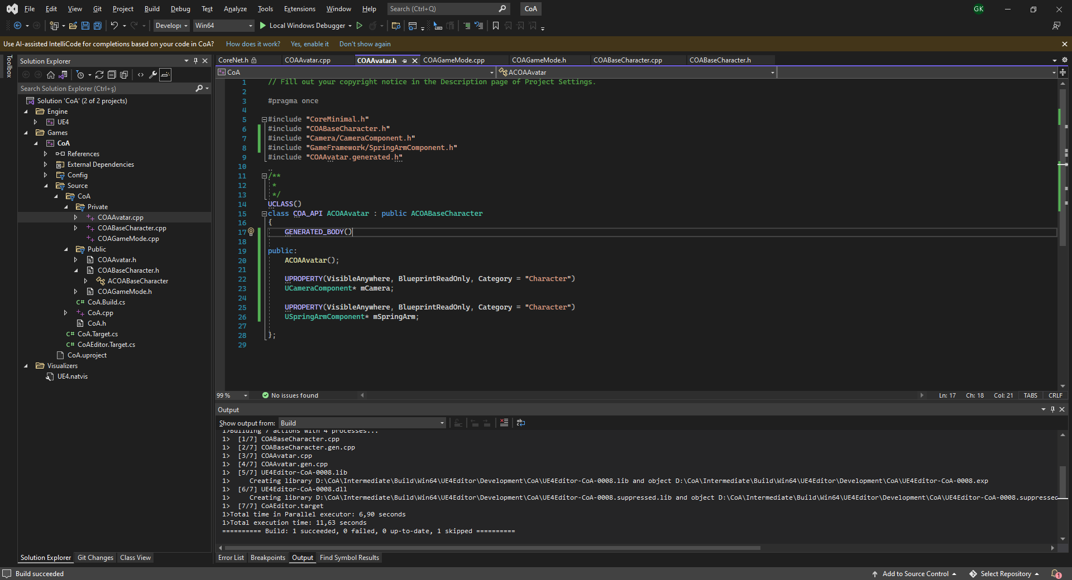
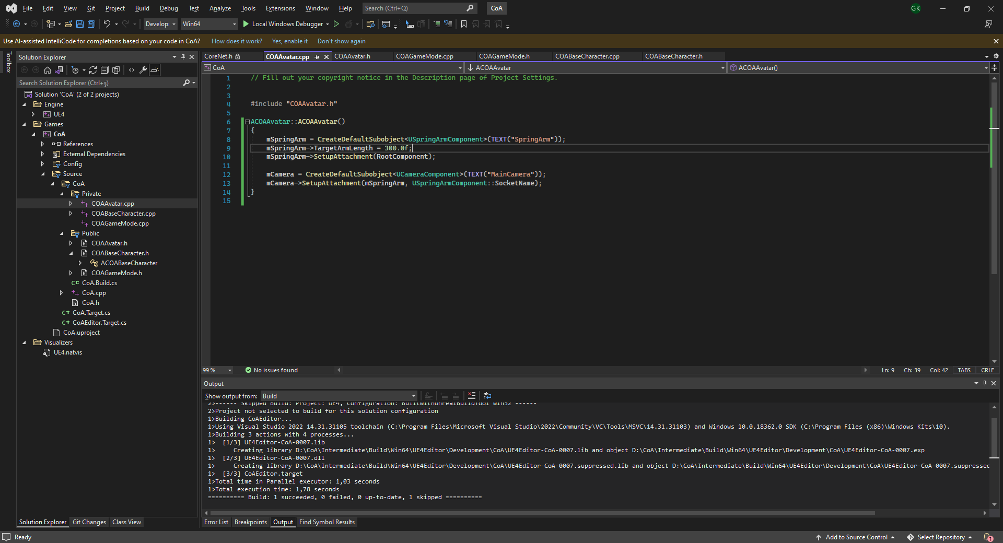
CAMERA AND SPRINGARM
Implementation Steps #2 (COMPLETE!)
Add New C++ Class and pick show all classes and derive from COABaseCharacter. Name it to COAAvatar.
Reparent BP_Avatar by going Class Settings and picking Parent Class as COAAvatar.
Add a USpringArmComponent and UCameraComponent to COAAvatar.cpp.
Close editor and compile the code and restart if changes weren’t reflected to BP_Avatar.

Slide 39
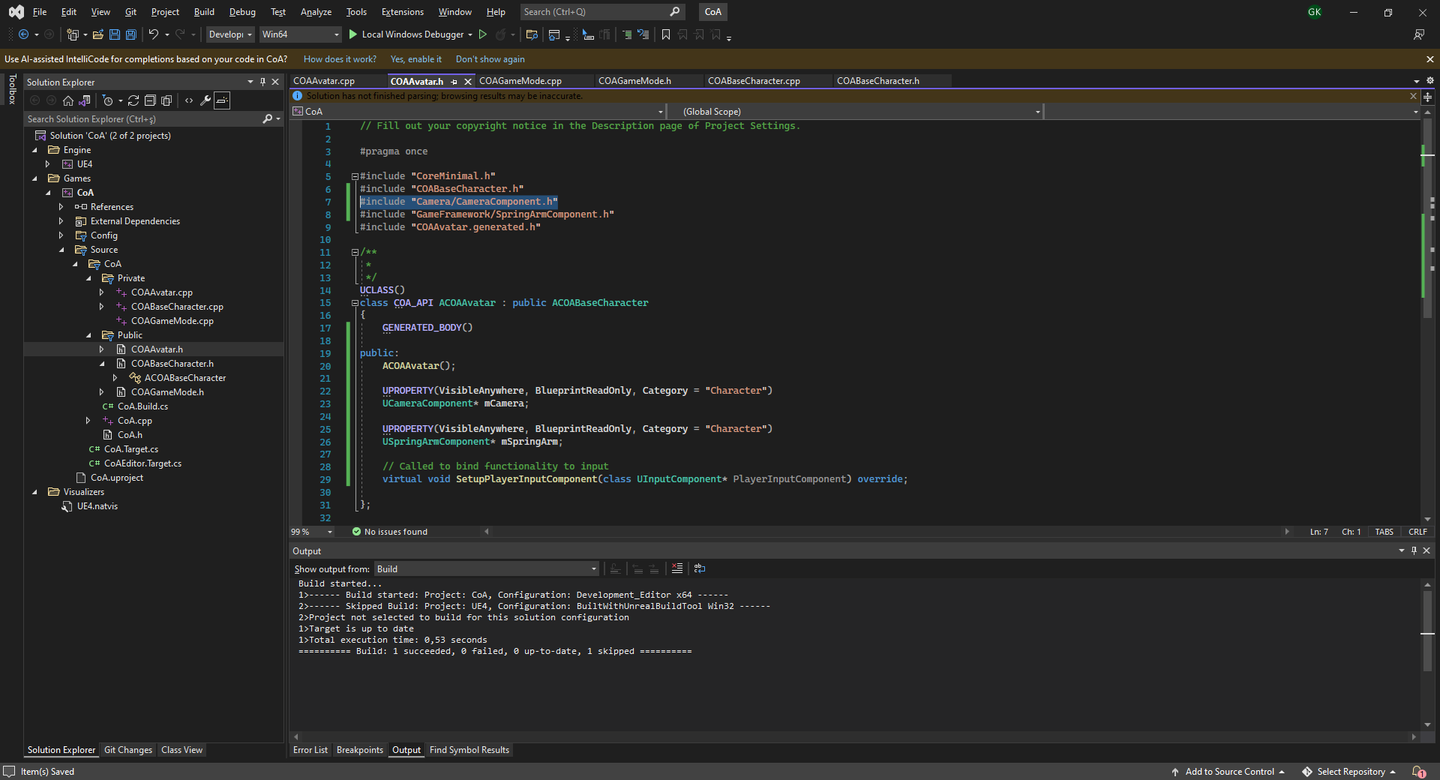
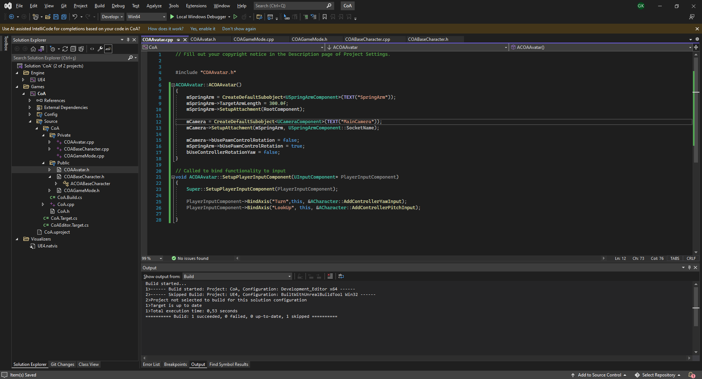
TURN AND LOOKUP INPUTS
Implementation Steps #3
Move SetupPlayerInputComponent() method definitions from COABaseCharacter.h to COAAvatar.h and .cpp source files.
Also move #include "Camera/CameraComponent.h«
Add Axis bindings for «Turn» and «LookUp» events using PlayerInputComponent->BindAxis()
Set use of controller axis rotation only limited to Spring Arm component by setting bUsePawnControlRotation = true;
Set Camera and Pawn controllerrotation copying settings to false;

Slide 40
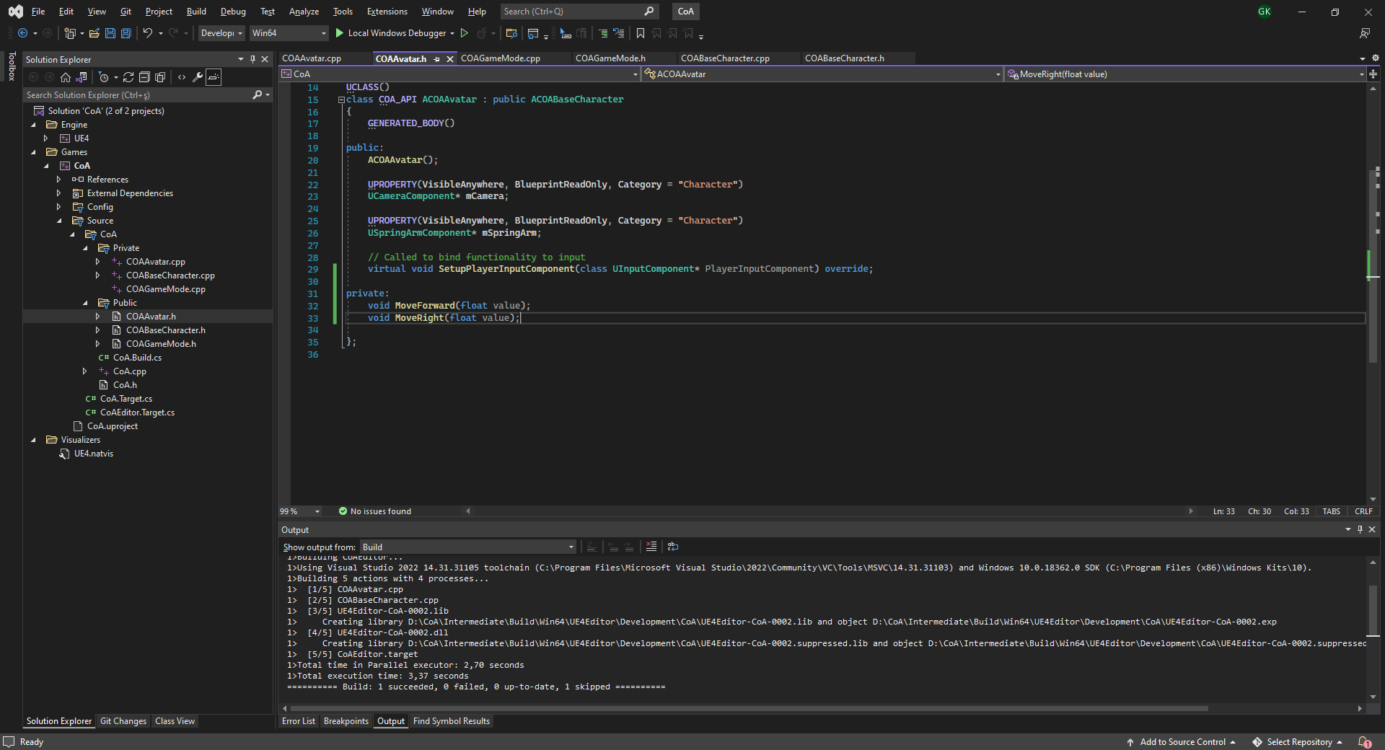
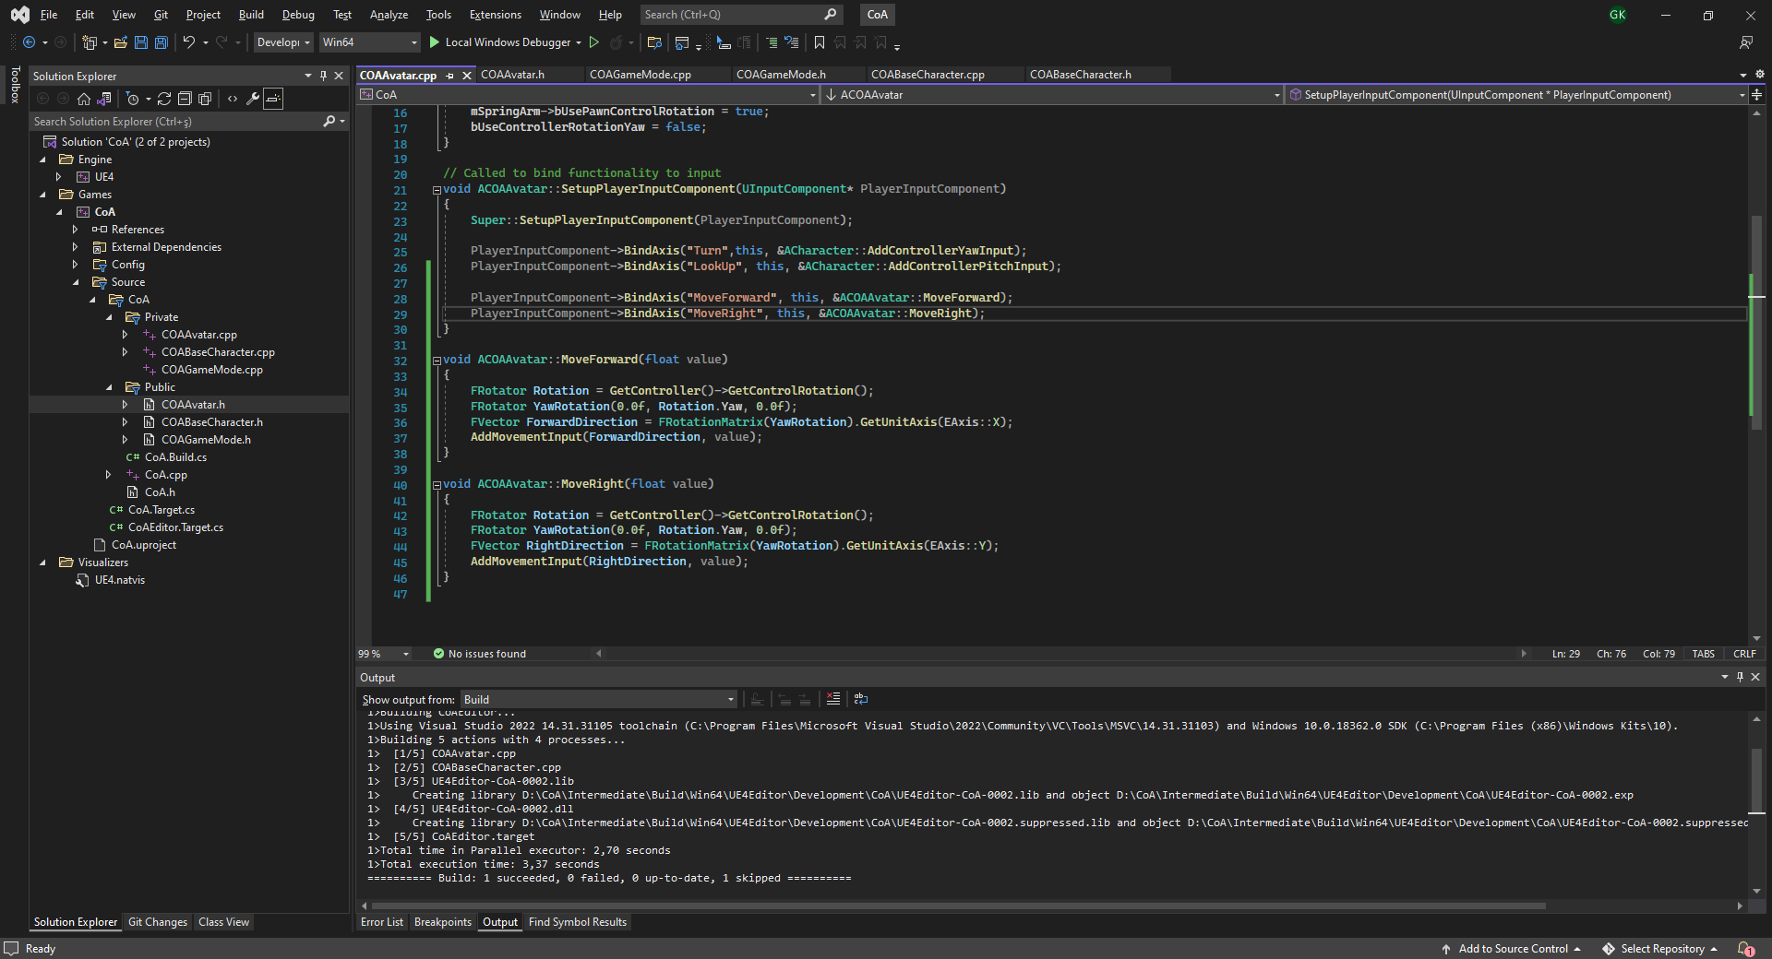

MOVEMENT INPUT
Implementation Steps #4
Create private MoveForward() and MoveRight() methods in ACOAAvatar class.
BindAxis() for «MoveForward» and «MoveRight» events with these function.
Implement movement direction calculation in these methods using GetConroller()->GetControllerRotation() and FRotationMatrix() class.
Make charactermovementcomponent to ortient the direction of the player to the movement direction by implementing it in ctor of ACOABaseCharacter(). Since this could be common for all game’s characters’ movement.

Slide 41


WALKSPEED AND HITPOINTS
Implementation Steps #5
Add these properties: bDead, Health, MaxHealth,HealingRate,Walkspeed on ACOABaseCharacter.h.

Slide 42


RUNNING
Implementation Steps #6
Add RunSpeed property to COAAvatar.h and set a default value.
Add «Run» action bindings at project settings and assign it to Left Shift.
Implement RunPressed() and RunReleased() methods and bind them to Run key event.

Slide 43
PROPERTIES TO ADD:
Stamina
MaxStamina
StaminaGainRate
StaminaDrainRate
RunSpeed
bStaminaDrained
bRunning
METHODS TO IMPLEMENT:
UpdateMovementParams() :
Sets the correct movement speed based on stamina state.
RunPressed()
RunReleased():
Edit these based on the new implementation.
Tick():
Update stamina here.
Use this code to check if player is in walking state:
GetCharacterMovement()->MovementMode == EMovementMode::MOVE_Walking
LABWORK:
STAMINA SYSTEM
Implement a stamina system at ACOAAvatar class as explained below:
Player starts at MaxStamina. (=100)
As they walk stamina get drained StaminaDrainRate per second.
As they don’t walk stramina gets increased StaminaGainRate per second.
When Stamina reaches zero player enters into StaminaDrained state and a flag becomes true.
Player has to stay in walking speed till the Stamina reached MaxStamina. After that, the flag becomes false.

